Slide 1
Arena Setup Guide Primary Division

Slide 2
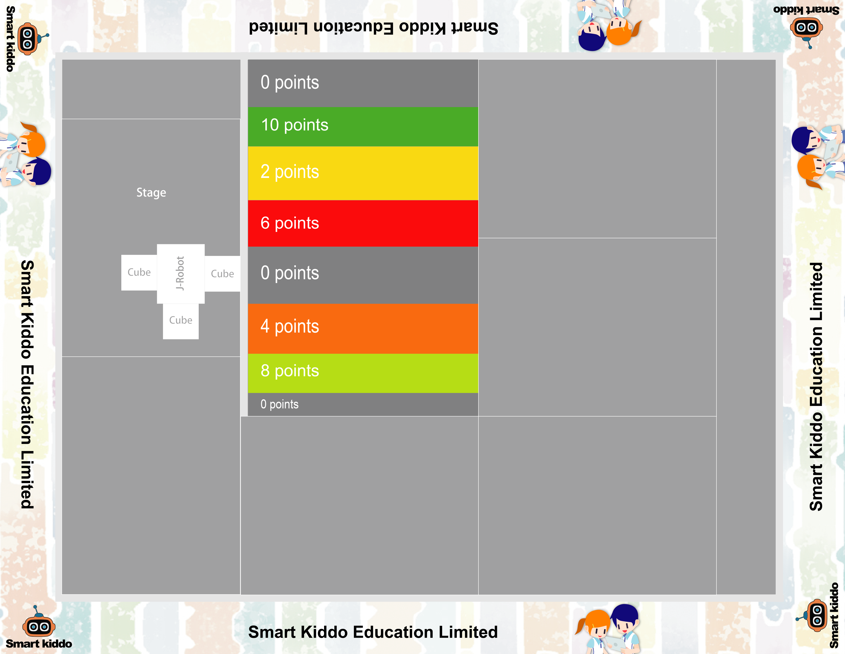
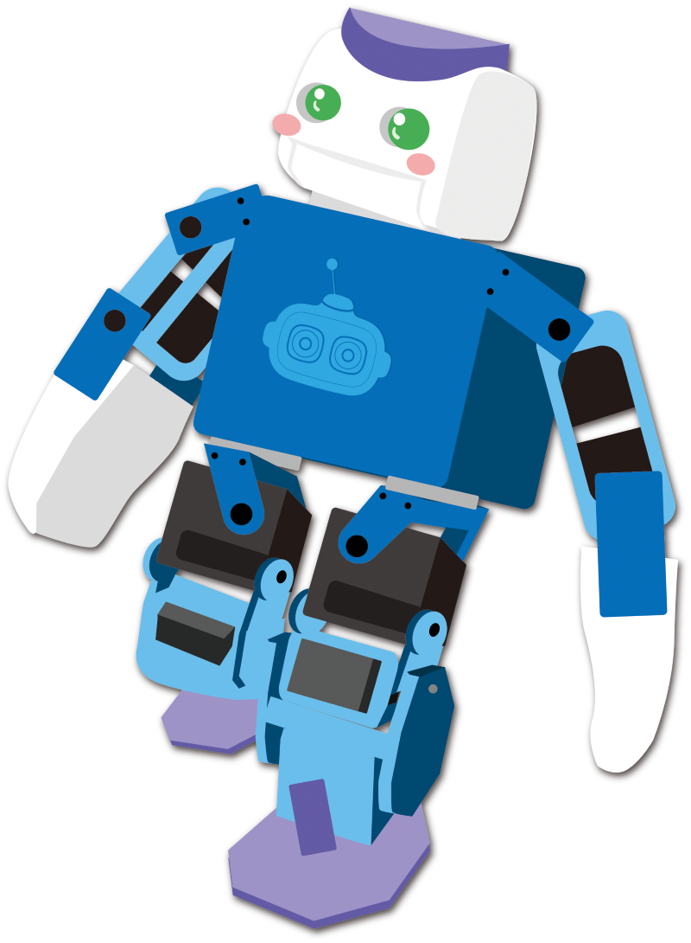
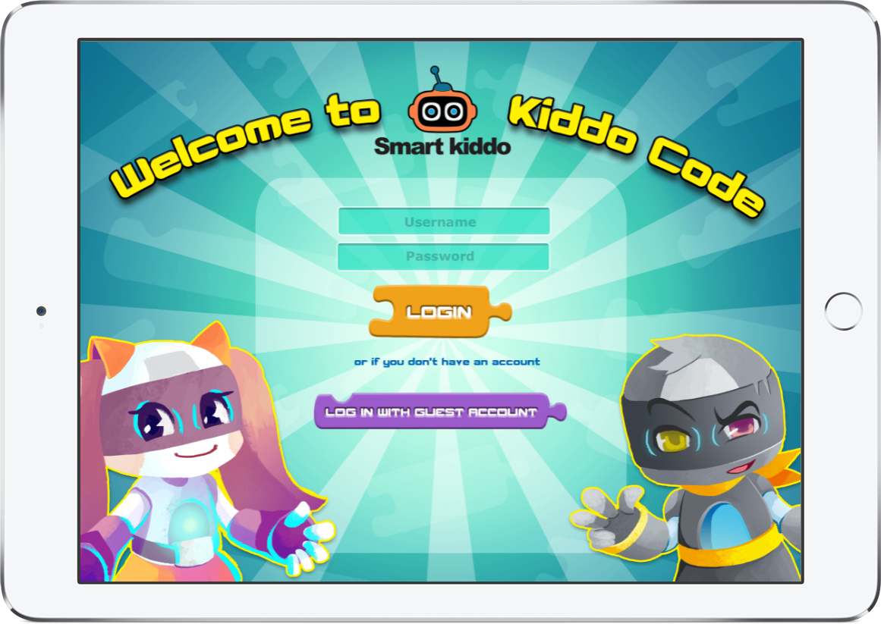
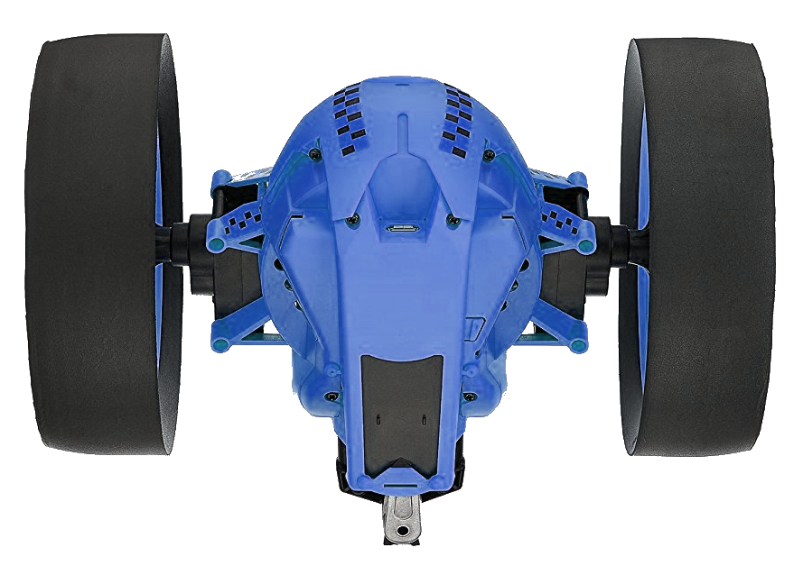
Primary - Round A
110cm x 142 cm 3mm PVC mat x 1
10cm x 30cm wooden board x 14
Metal plate x 10
Right angle metal plate x 4
iPad x 2
Yellow cube (6.5x6.5x6.5cm) x 4
Basket (15.2x23x6 cm) x 1
Jumping Sumo Non-White Color x 1
J-Robot x 1
Partition x 1 (competition only)
3mm PVC Mat
Partition
J-Robot
Cube
metal plane
Players
Jumping Sumo
Right angle metal plane

Slide 3
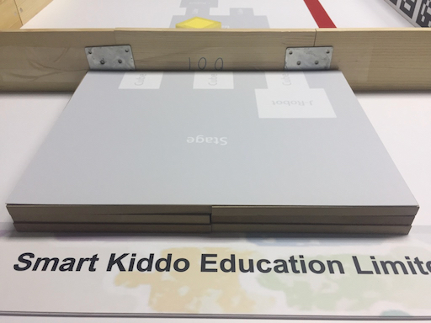
Primary - Round A
Raised Platform Installation
30cm x 40 cm 3mm PVC mat
~ 4 cm
20cm x 30cm wooden board x 6

Slide 4
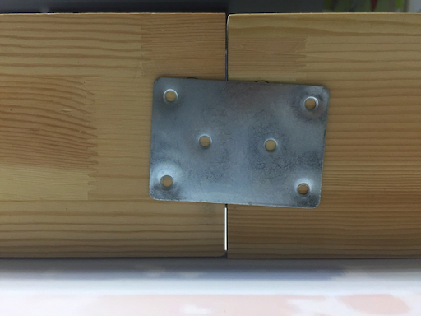
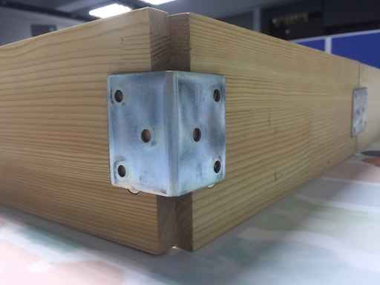
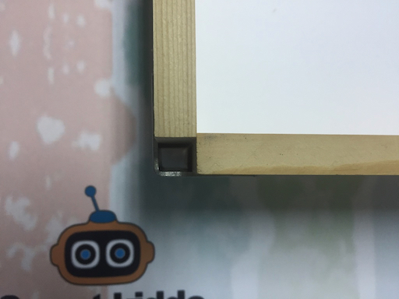
Primary - Round A
Wooden Fence Installation
Metal plate
Right angle metal plate
10cm x 30cm wooden board with magnets at both ends
Topview
Right angle metal plate

Slide 5
PRIMARY - Round B
140cm x 200 cm 3mm PVC mat x 1
10cm x 30cm wooden board x 20
Metal plate x 16
Right angle metal plate x 4
Yellow cube (6.5x6.5x6.5cm) x 5
Jumping Sumo Night x 4
iPad x 4
1mm plate A (10x30cm) x 1
1mm plate B (10x30cm) x 1
Label A for Team A’s Jumping Sumo x 2
Label B for Team B’s Jumping Sumo x 2
Partition x 2 (competition only)

Slide 6
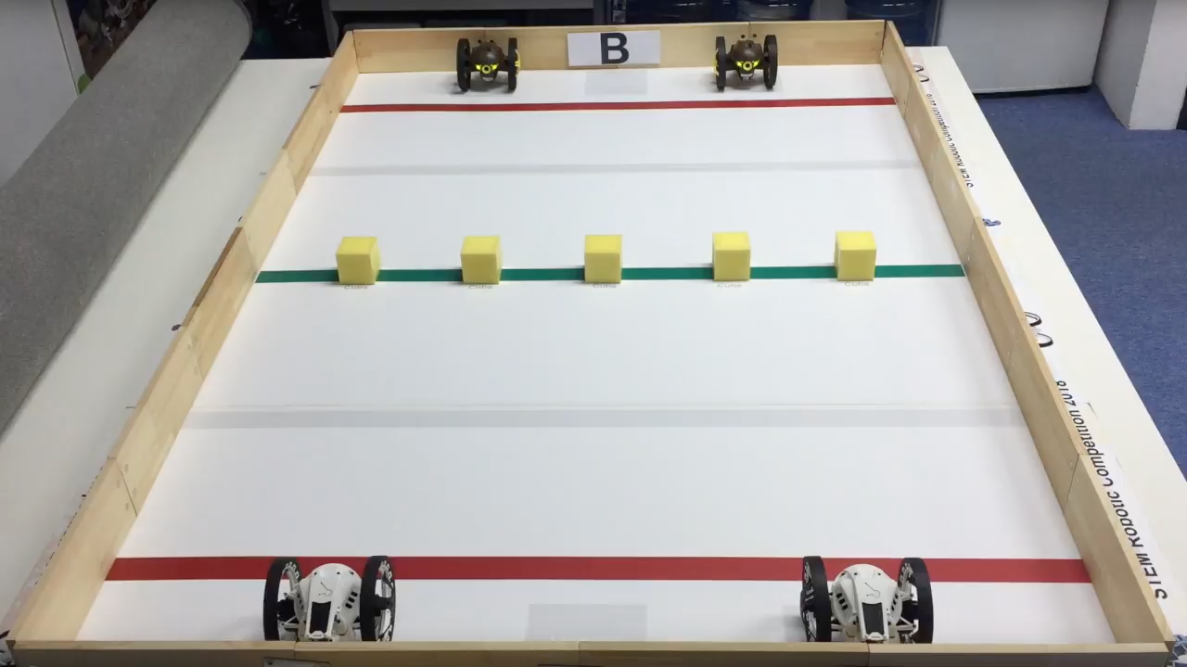
PRIMARY - Round B

Slide 7
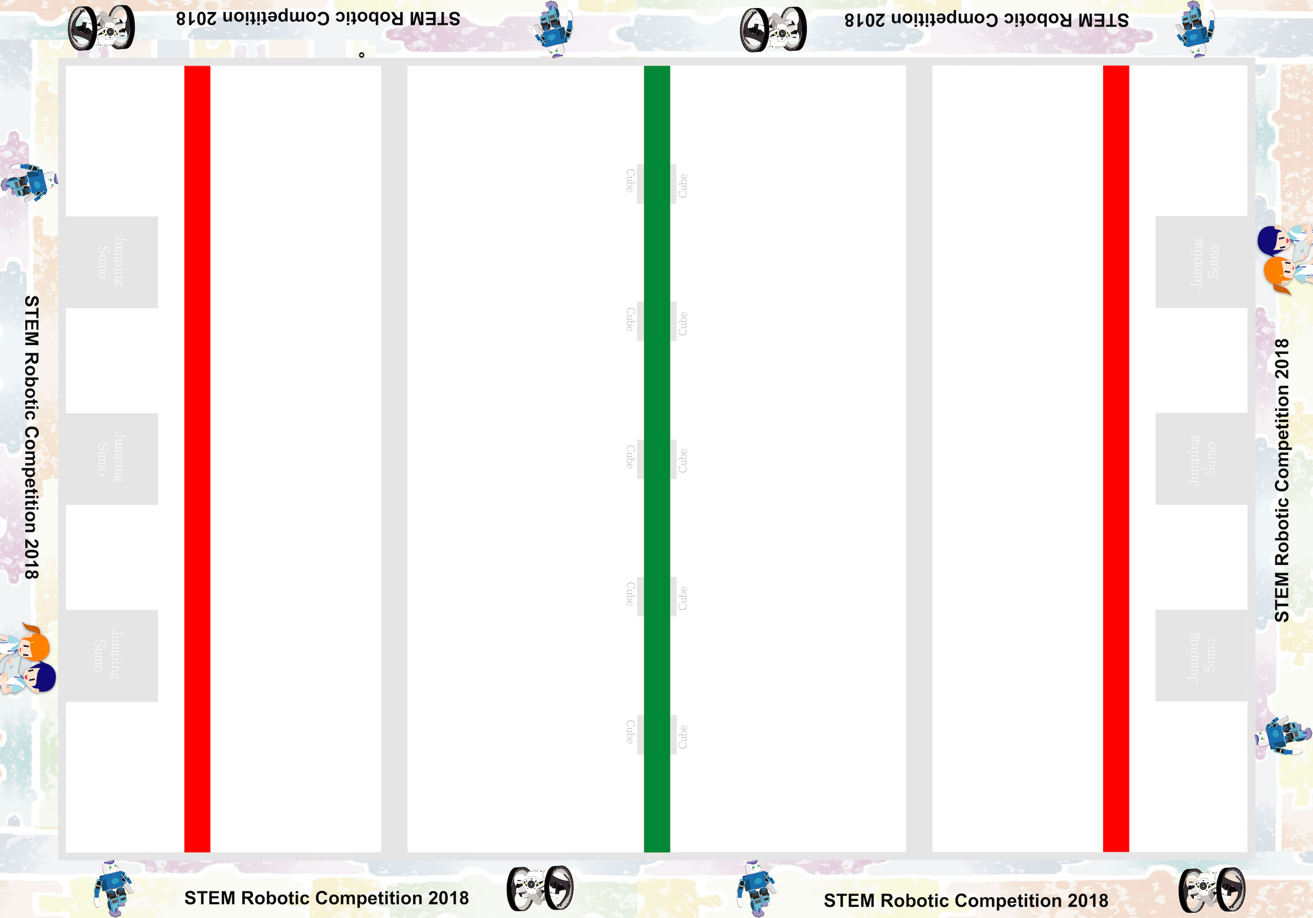
PRIMARY - Round B

Slide 8
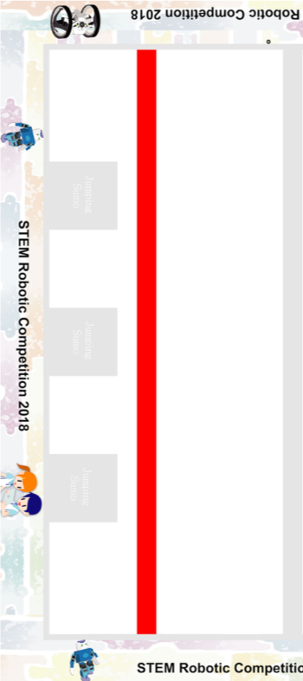
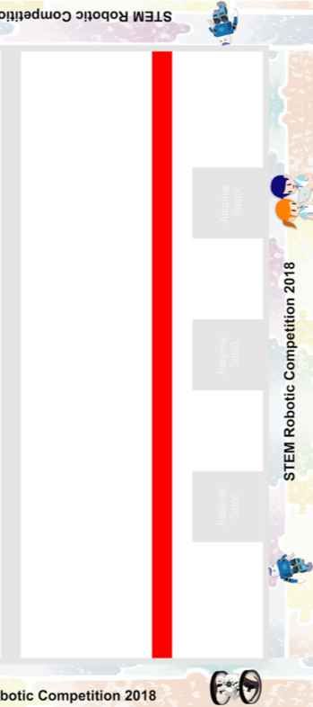
PRIMARY - Round B
apply adhesive tape here
apply adhesive tape here

